Slide 1
Early Literacy and Numeracy
Jessica Bowman, TIES Center / National Center on Educational Outcomes (NCEO)
Liz Hartmann, CAST / TIES Center
Gail Ghere, TIES Center / NCEO

Slide 2
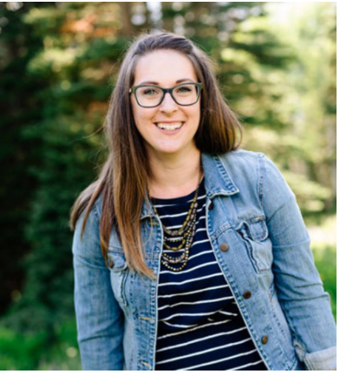
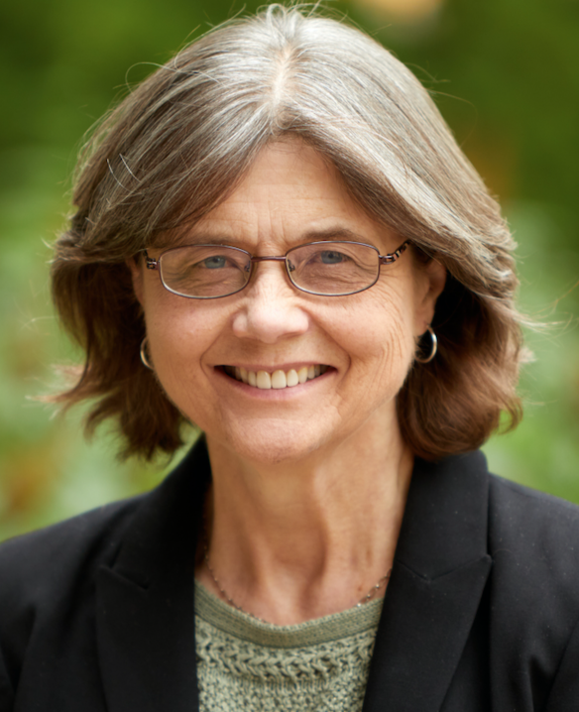
Introductions (1 of 2)
Jessica Bowman
Liz Hartmann
Gail Ghere
National technical assistance center on inclusive practices and policies with a focus on students with significant cognitive disabilities.
tiescenter.org /nceo.info
Notes:
Chat - share your name, role, state, the holidays are coming up, no matter how you celebrate - what are some of your favorite holiday foods or activities?

Slide 3
Introductions (2 of 2)
In the chat
Your name
Location
What is one of your favorite holiday foods or activities?
Notes:
Chat - share your name, role, state, the holidays are coming up, no matter how you celebrate - what are some of your favorite holiday foods or activities?

Slide 4
Agenda: Today we will...
Discuss early literacy and how to embed into everyday routines and activities
Discuss early numeracy and how to embed into everyday routines and activities
Focus on partnering with parents / guardians

Slide 5
TIES Center -
What does TIES stand for?
Time (T)
Increasing the number of students included in grade-level general education classrooms majority (at least 80%) of school day
Instructional Effectiveness (I)
Collaboration across educators and specialized instructional support personnel to provide curriculum and instruction in general education classroom
Engagement (E)
Engagement
Engagement with general education curriculum AND age-grade peers
Support (S)
Support
Support at both state and district level and shared ethic of thinking inclusion first
Notes:
Chat - add links in chat, highlight some key points

Slide 6
Who does TIES support?
Educators
Parents
State, District & School Administrators
What does TIES focus on?
Communicative Supports
Inclusive Instruction
Peer Engagement
Systems Change

Slide 7
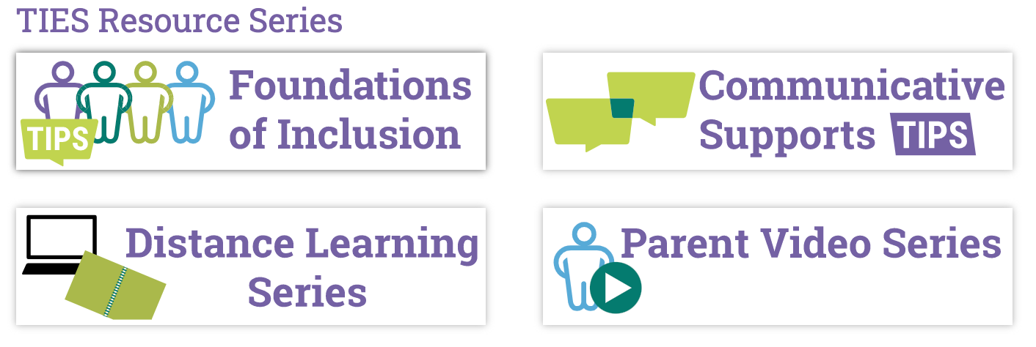
Major Series:
Notes:
Helping my child with:
Routines at Home
Foundations of Communication at Home
Communication at Home
Academics at Home
Foundations of Reading at Home
Reading at Home
Foundations of Math While at Home
Math While at Home
Foundations of Writing While at Home
Writing While at Home
Checking Progress in Knowledge and Behavior at Home

Slide 8
Feedback from last session
More about providing information to the deaf-blind students that depend on tactile signing would be helpful.
Discuss how to present this content to teams without overwhelming teachers
Talk about distance learning, as that is the biggest challenge facing the providers I support right now
Specifically address these practices and tools can be useful for teams serving learners with deafblindness and extensive support needs
Share real-life examples and strategies you have used and know can be effective
Notes:
Specific tools and practices - we are here to introduce some new ideas to you
TIES focus is so much on inclusive education, part of our goal is to provide that to this audience. We encourage you to participate and bring that in yourself. We see this as a collaboration.

Slide 9
Parents as partners
Helping Your Child with Academics Video

Slide 10
STOP and SHARE 1
What resonates with you in the video?
How might a home-school discussion about standards-based instruction support student learning?
Notes:
Poll question

Slide 11
Multi-tiered Systems of Support (MTSS)
TIER 1: Core instruction
All students receive access to general education core content
TIER 2: Additional instruction--
Some students
Pre-teach or Reteach
TIER 3: Individualized Instruction
A few students
Individualized instruction; help fill gaps in learning

Slide 12
MTSS is an inclusive and additive framework

Slide 13
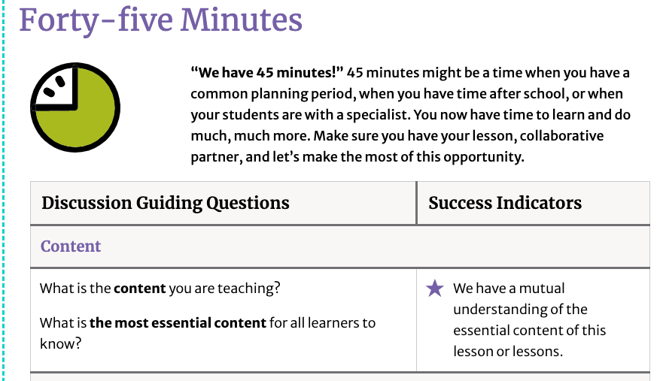
TIES 5-15-45 tool (1 of 3)
Notes:
This will be our organizer, focusing on the 45 min tab

Slide 14
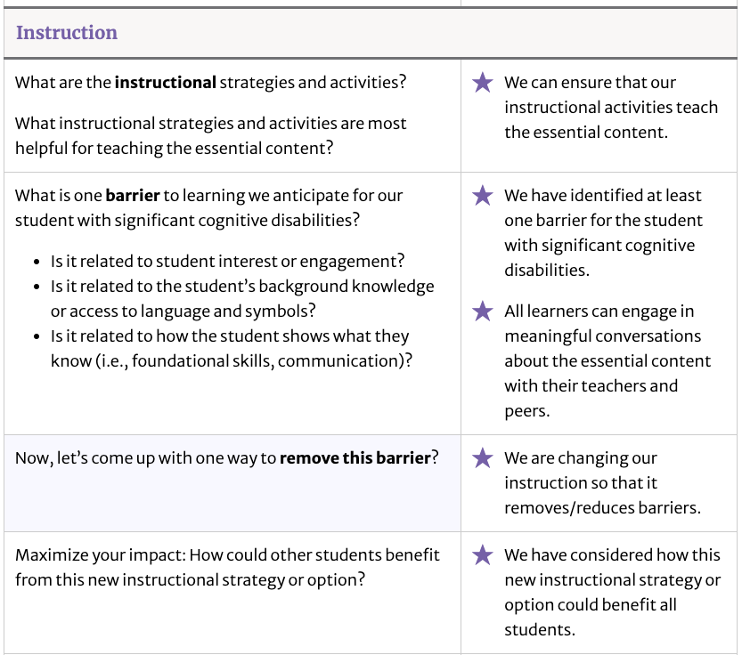
TIES 5-15-45 tool (2 of 3)

Slide 15
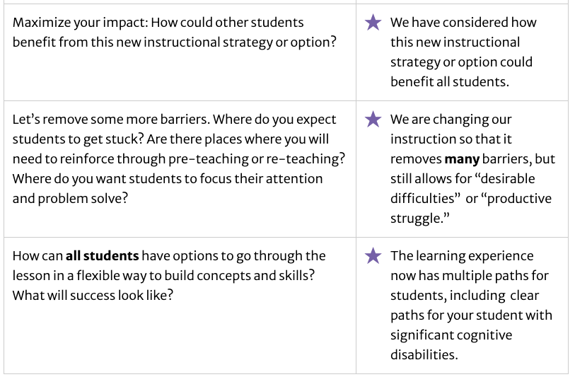
TIES 5-15-45 tool (3 of 3)

Slide 16
Early literacy

Slide 17
Early literacy standards for all
Integrated Literacy:
Reading,
Writing,
Speaking,
Listening,
Language
Across a range of subjects and contexts
Media skills blended into early literacy
Focus on results not means
Notes:
Let’s begin by first thinking about what we mean by “literacy”
In it’s broadest sense, in public schools, we’ve seen a focus on an integrated literacy approach - championed by EBP in literacy and manifesting in the ELA common core. It is important to remember with the common core ELA Standards -the ultimate goal is to meet or exceed requirements for college and career readiness.
For a range of subjects - not just ELA. Necessitates collaboration across subject areas
Emphasis on new media and the importance of thinking of integrated literacy as being more than just print or books - it is social media, youtube, apps, etc.
And this last point is a good one for us in the field of dbness - there is increasing emphasis on results not means - meaning that If the goal of literacy is to be able to connect with others, discuss ideas, share emotions and experiences that are meaningful to us, then how we do that is less important than that we do it. This provided flexibility for the many different means that children with dbness communicate - objects, gestures, biobehavioral cues.
Where are the barriers for students with deafblindness?

Slide 18
Early literacy skills and deafblindness
Literacy as a right
Literacy is communication, behavior as communication
Trusting relationships are key
Founded on experiences and concept development
Embedded throughout day and routines
Designed to be meaningful, age-appropriate
Exists along a developmental continuum
Literacy for Children with Combined Vision and Hearing Loss
Notes:
“Every day, give students opportunities to engage in reading and writing experiences involving purposeful use of text. Alphabet knowledge and phonological awareness are important but should not be the sole focus of instruction.” Erickson and Koppenhaver, 2020, (p. 11)
emergent literacy to independent literacy.
Its not just for some
Literacy is tied to communication and behavior
Trusting relationships tied to communication
Most children developmentally have literacy that follow their experiences, but sw dbness, there can be a disconnect
Embedded -
Don’t want kids with scd to be limited by their perceived development
Earliest parts of the continuum are glossed over for kids with dbness, end up in public schools in grade 2 (curriculum centered on average 2nd grader developmentally, they may not match this perception, then we can overlook the developmental continuum at its earliest stages and engage them in those activities that are meaningful. We DON’T mean that this instruction will happen only at this part of the continuum ,but that the supports will be available no matter what a class is doing (low floor, high ceiling) students with seizure disorders, bad day, may need to go from print back to objects

Slide 19
STOP and SHARE 2
Where do you notice the similarities and differences in these approaches?
Approach for learners who are deaf-blind
Literacy as a right
Literacy is communication, behavior as communication
Trusting relationships are key
Founded on experiences and concept development
Embedded throughout day
Designed to be meaningful, age-appropriate
Exists along a developmental continuum
Standards-based approach
Integrated Literacy:
Across a range of subjects and contexts
Media skills blended into early literacy
Focus on results not means
Notes:
Poll question

Slide 20
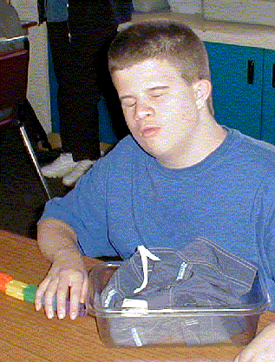
Reading
Focus on relationships and routines
Embed objects, symbols
Explore reading materials
Print
Braille
Objects
Signs
Make reading enjoyable, accessible, interactive
Recreation, leisure
Notes:
From corestandards.org: To build a foundation for college and career readiness, students must read widely and deeply from among a broad range of high-quality, increasingly challenging literary and informational texts. Through extensive reading of stories, dramas, poems, and myths from diverse cultures and different time periods, students gain literary and cultural knowledge as well as familiarity with various text structures and elements. By reading texts in history/social studies, science, and other disciplines, students build a foundation of knowledge in these fields that will also give them the background to be better readers in all content areas. Students can only gain this foundation when the curriculum is intentionally and coherently structured to develop rich content knowledge within and across grades. Students also acquire the habits of reading independently and closely, which are essential to their future success.
Students won’t read or engage in literacy unless they’re doing so with someone they have a relationship with, it is a shared activity, you can’t tak the shared part for granted. Reading will unfold from a trusted relationship. A routine is also needed.
What do swDb read? Objects and symbols. Clayton had a calendar system that used objects, he had a bin and knew whatever object was in the bin was the next thing in his schedule. Its an anticipation calendar. He has his swim trunks in the box, so going to his desk, he’d feel the swim trunks so he was going to visit swim class next.
Multi-modal reading materials - leveraging the strengths of the child, residual vision and hearing. Only 10% are completely blind and deaf. Can always use touch based media.
Thinking of it not just as academic, its important to have it as something to do for fun.
Clayton is engaging in a literacy task that isn’t just helpful at school for him but at home as well.

Slide 21
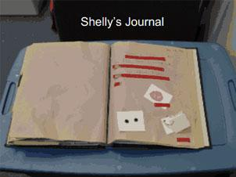
Writing
Unconventional forms
Makes thoughts or concepts “stick”
Routines and activities are key
Make it meaningful and personal - journaling
Make reading enjoyable, accessible, interactive
Self-expression, recreation, leisure
Notes:
Shelly "writes" in her daily journal by choosing tactile representations of activities she wants to write about. Print and braille are added. The book goes home daily to provide Shelly's family with topics for conversation.
From corestandards.org:To build a foundation for college and career readiness, students need to learn to use writing as a way of offering and supporting opinions, demonstrating understanding of the subjects they are studying, and conveying real and imagined experiences and events. They learn to appreciate that a key purpose of writing is to communicate clearly to an external, sometimes unfamiliar audience, and they begin to adapt the form and content of their writing to accomplish a particular task and purpose. They develop the capacity to build knowledge on a subject through research projects and to respond analytically to literary and informational sources. To meet these goals, students must devote significant time and effort to writing, producing numerous pieces over short and extended time frames throughout the year.
Writing may not be print or braille, but it could be tactual representations (felt circle represents a cubby, feels along the cubby and knows its theirs) Given those circles, the child could write their name.
What they end up writing about is what they think about, what they thin kabout is what they remember.
So important that its meaningful, journaling is child-centered, personal. Its one of the first things we all do that helps us understand why we like to do it.
Writing has a purpose of self-expression.

Slide 22
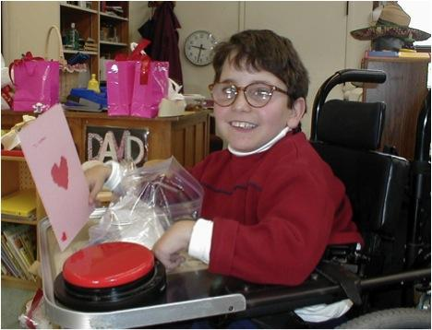
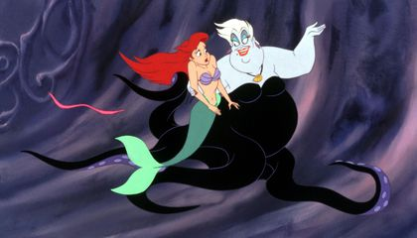
Speaking & Listening
We are literate WITH others - peers, teachers, small groups, partners, whole class
Conversations
Technologies and digital media
Social and emotional support or expression
Notes:
From corestandards.org:To build a foundation for college and career readiness, students must have ample opportunities to take part in a variety of rich, structured conversations—as part of a whole class, in small groups, and with a partner. Being productive members of these conversations requires that students contribute accurate, relevant information; respond to and develop what others have said; make comparisons and contrasts; and analyze and synthesize a multitude of ideas in various domains.
New technologies have broadened and expanded the role that speaking and listening play in acquiring and sharing knowledge and have tightened their link to other forms of communication. Digital texts confront students with the potential for continually updated content and dynamically changing combinations of words, graphics, images, hyperlinks, and embedded video and audio.
DB experts realize that speaking and listening is literacy. Communication is a center of everything you do with students who are DB.
Conversations and back and forth is really important, students may be working on this, turn taking with a reliable and trusted communication partner. Others may be very conversational.
Tech - all of the kids were on tablets for free time, digital media is very important to kids, they are good at it, it is how their friends are connecting. Even things you wouldn’t think they have visual or auditory access to, they somehow do.
Social - a student who had an scd and dbness and was thought to be on this basic level in communication, but really liked disney movies. Were able to talk about very complex emotional states because of disney movies. Ursula is bringing ariel is nervous and anxious. The student was able to connect with this digital media, the student had a real literacy, were able to talk about how he felt during that time. Concept was in the child, but they didn’t know it/have a label for it, they do know what Ursula feels like.
Documentary about a student with autism
Learning Media assessment

Slide 23
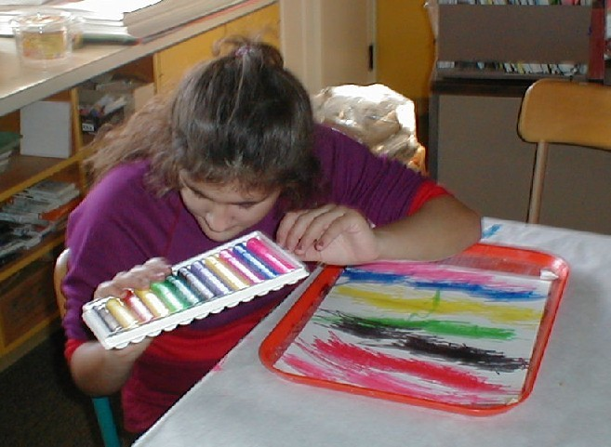
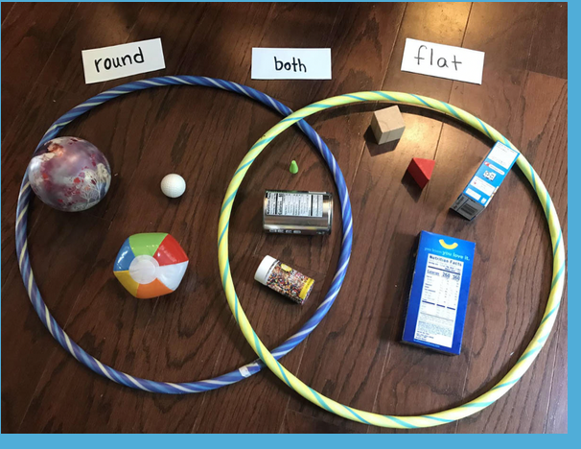
Language
Conventions of English, other modes or media
Mechanics of language
Notes:
From corestandards.org:To build a foundation for college and career readiness in language, students must gain control over many conventions of standard English grammar, usage, and mechanics as well as learn other ways to use language to convey meaning effectively. They must also be able to determine or clarify the meaning of grade-appropriate words encountered through listening, reading, and media use; come to appreciate that words have nonliteral meanings, shadings of meaning, and relationships to other words; and expand their vocabulary in the course of studying content. The inclusion of Language standards in their own strand should not be taken as an indication that skills related to conventions, effective language use, and vocabulary are unimportant to reading, writing, speaking, and listening; indeed, they are inseparable from such contexts.
Compare and contrast made accessible to a child who is deafblind
Illiana had very low vision but had a small crescent window that she could see through and could see colors so loved to do art. Smelly markers. She created this picture. She is an example of a student that cognitively, people thought she was at a very concrete level but she wasn’t able to understand braille, tried print but couldn’t see it. She would do art and use the colors “yellow like the sun. Green like the fresh grass” concepts would come out of her that showed she knew how to use language. Low floor, high ceiling. We might think they may not be able to understand because they’re so abstract, but we can see how they play with language in their day to day life, that becomes the point of access.

Slide 24
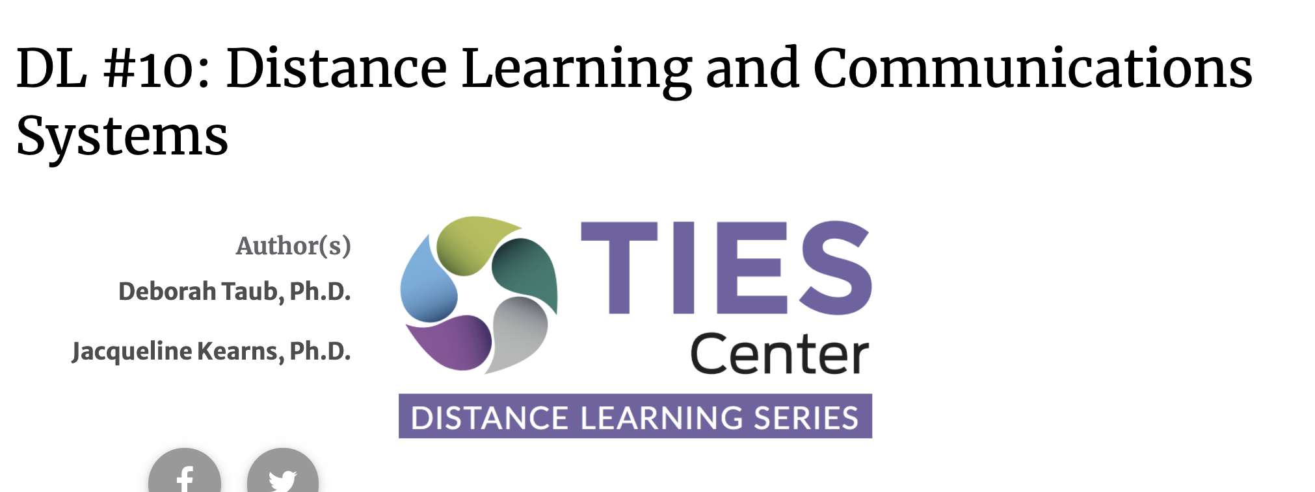
TIES Literacy Resources
Notes:
TIP 5 - lots of good points about using peers
DL - gets to the point around distance learning

Slide 25
Embedding literacy at home/community
Home - school journals
Experience boxes
Shared story books with objects
Collaboration and communication is key
What else?
Notes:
Home school journal, could send an object home with the child, a manipulative from a math lesson, pair with an email or print, ask parents to talk about it as the child is feeling it
Experience boxes, with objects or other tactual representations to remember something that’s happened. Clayton’s favorite experience box was the empty McDonalds containers, smell the french fries and the hamburger, very motivating
Shared story books, pairing with objects, Perkins school for the blind has a whole series of books that comes with objects
Main point, there needs to be collaboration and communication

Slide 26
STOP and SHARE 3
What other ideas do you have for embedding literacy into home/community for students who are deaf-blind?
Notes:
Poll question
General ed vs. DB

Slide 27
Early numeracy

Slide 28
The importance of early numeracy skills
Strong predictor of future mathematical understanding (Denton & West, 2002; National Mathematics Advisory Panel, 2008)
Accessing the general education curriculum

Slide 29
Standards for mathematical practice
Make sense of problems and persevere in solving them
Reason abstractly and quantitatively
Construct viable arguments and critique the reasoning of others
Model with mathematics
Use appropriate tools strategically
Attend to precision
Look for and make use of structure
Look for and express regularity in repeated reasoning

Slide 30
Early numeracy skills
Rote counting
Number identification
One-to-One correspondence
Creating sets
Composing and decomposing numbers
Comparing quantities

Slide 31
Counting
Identify numbers in a sequence
“1, 2, 3, 4, 5”

Slide 32
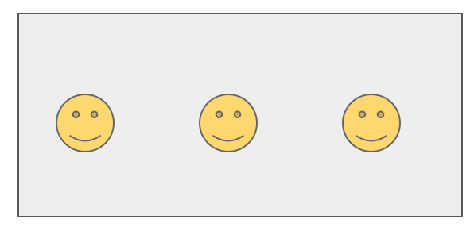
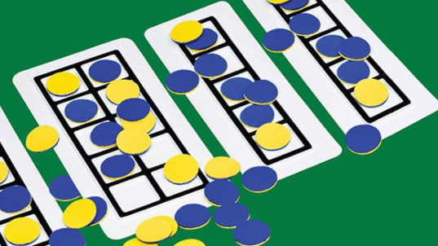
One-to-one correspondence
Coordinated counting by touching or moving objects
Moveable
Non-moveable
Notes:
cardinality

Slide 33
Number identification
Numbers are represented by names and numerical representations.
two

Slide 34
Making sets
Notes:
Once students have cadinality...

Slide 35
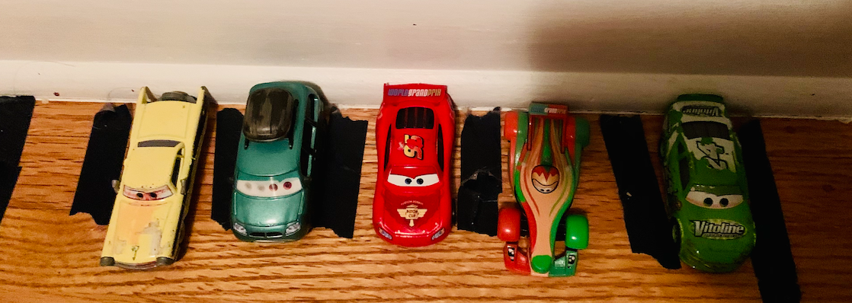
Embedding numeracy at home/community
How could early numeracy be embedded during home activities?
Doing chores
Taking a walk
Play

Slide 36
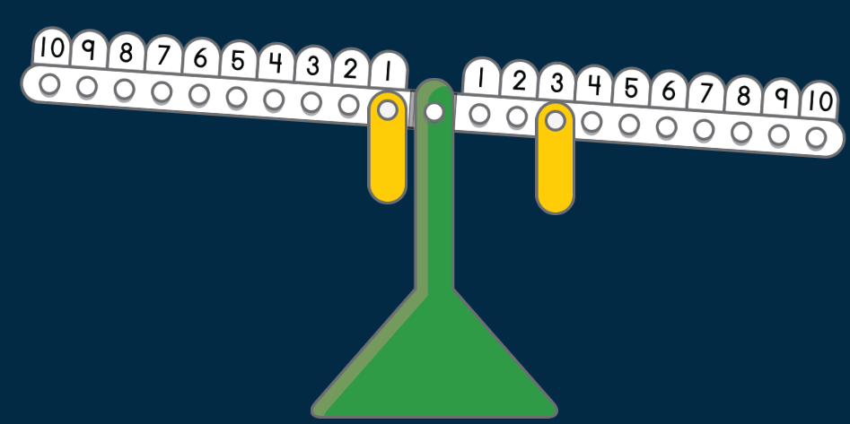
Composing and decomposing numbers (1 of 4)
1 + _ = 3
Notes:
Part part whole
Five frame
Ten frame

Slide 37
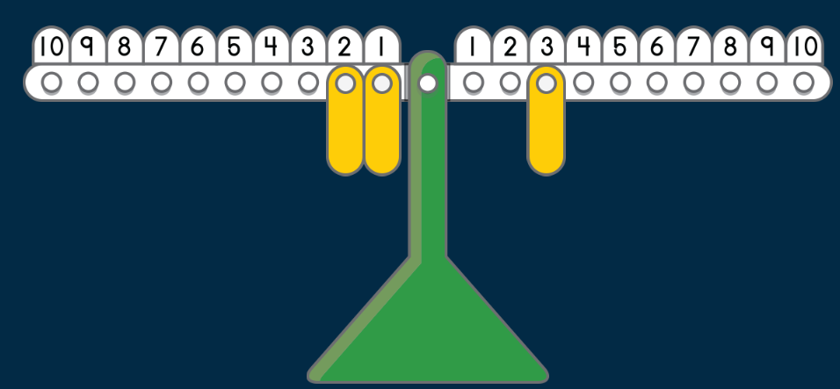
Composing and decomposing numbers (2 of 4)
1 + 2 = 3
Notes:
Part part whole
Five frame
Ten frame

Slide 38
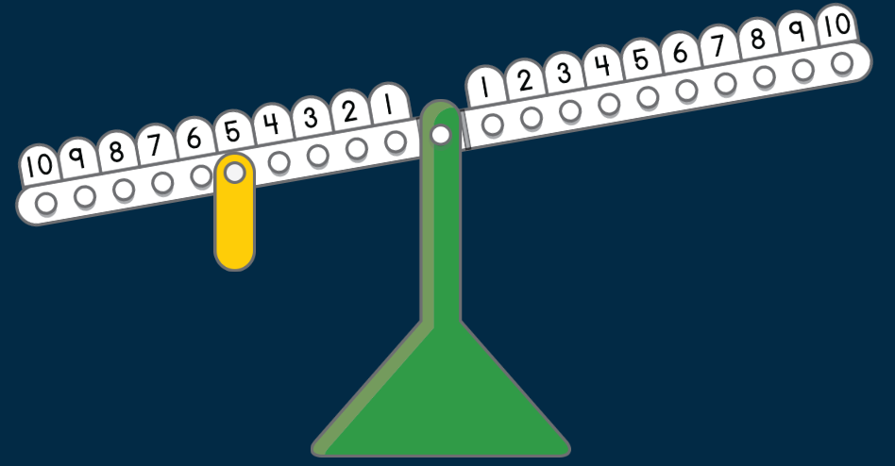
Composing and decomposing numbers (3 of 4)
5 = ?
Notes:
Part part whole
Five frame
Ten frame

Slide 39
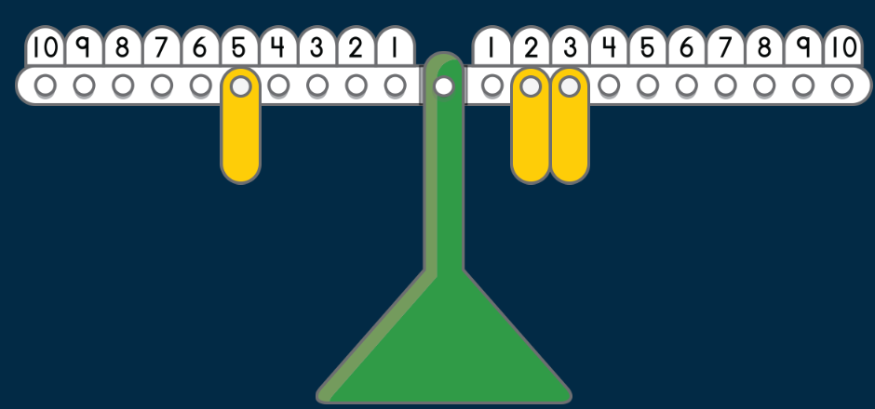
Composing and decomposing numbers (4 of 4)
5 = 3 + 2
Notes:
Part part whole
Five frame
Ten frame

Slide 40
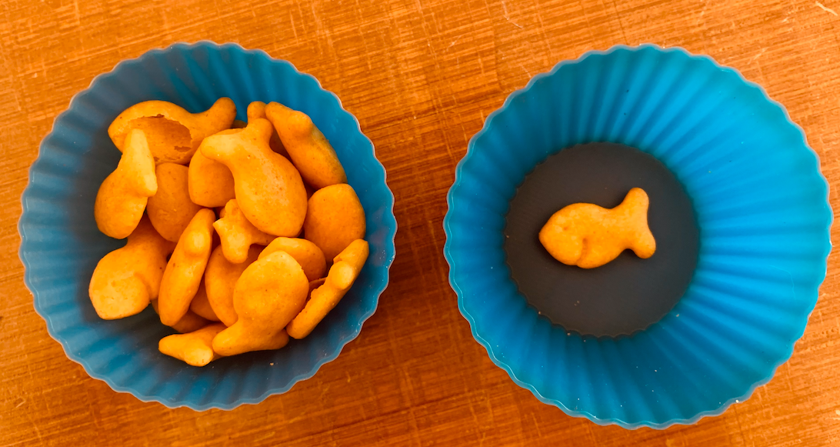
Comparing quantities
More / Greater than / More than enough
Less / less than / not enough
Same / enough

Slide 41
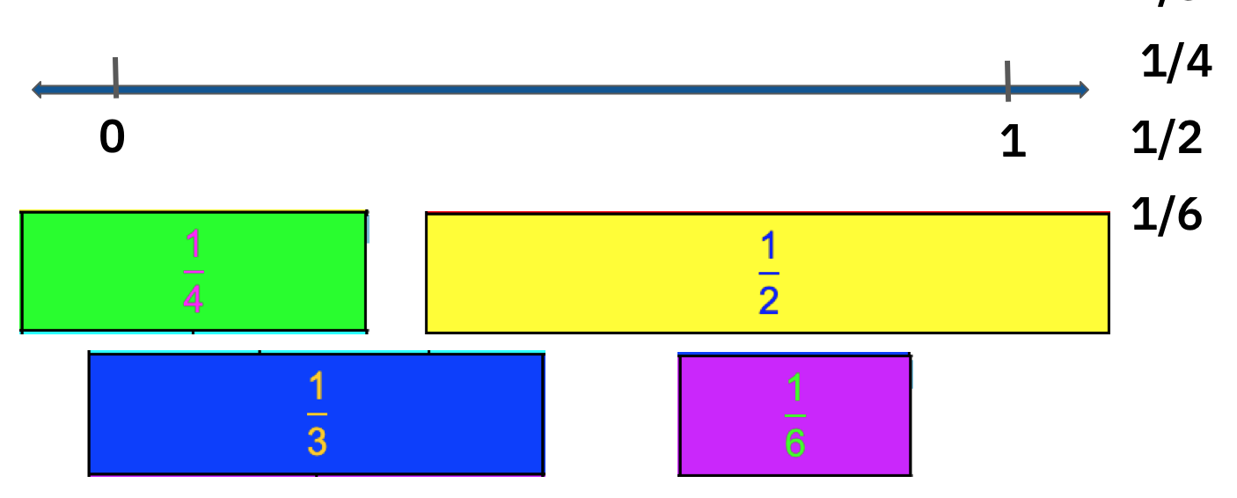
Embedding early numeracy in a grade-level lesson
5.MD.B.2 Make a line plot to display a data set of measurements in fractions of a unit (1/2, 1/4, 1/8). Use operations on fractions for this grade to solve problems involving information presented in line plots.

Slide 42
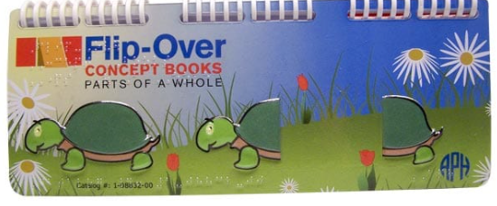
Opportunities to embed early numeracy
Comparing quantities
Identifying halves and wholes

Slide 43
STOP and SHARE 4
What other ideas do you have for embedding numeracy into home/community for students who are deaf-blind?
Notes:
Poll question

Slide 44
Thank you!
tiescenter.org

Slide 45
Please take the Early Literacy and Numeracy
Evaluation Survey
Notes:
Updated this to https://survey.alchemer.com/s3/6040906/Early-Literacy-and-Numeracy-Summit-Session Julie

Slide 46
Final Slide
The contents of this presentation were developed under a grant from the U.S. Department of Education, #H326T180026. However, those contents do not necessarily represent the policy of the U.S. Department of Education, and you should not assume endorsement by the Federal Government. Project Officer, Susan Weigert.

