Slide 1
Early Literacy Learning

Slide 2
What is Literacy?
Begins at birth
Linked to and builds on communication and social interaction
Exists along a continuum from Emergent to Independent
Literacy is a FUNDAMENTAL SKILL!

Slide 3
Literacy Development
The path to literacy requires
establishing communication
and
connecting meaning to
objects, events and people
Notes:
We’ve been talking about the communication piece. So. . . now let’s talk about making connections. Just as for infants and young children it involves providing vocabulary that they can connect to the people, objects and actions they experience everyday. But how do we go beyond words to concepts?
(next slide)
We provide vocabulary and incidental learning helps make sense of the context.

Slide 4
Early Literacy Skills
Print and book awareness
Symbols and Signs
Print and Braille
Letters and words
Writing
Handling books
Scribbling
Texts and pictures have meaning
Notes:
This exposure begins early and is part of very early emerging literacy. Hearing and sighted children become aware of environmental print just by participating in day to day activities. What’s one of the first “words” they read? “McDonald’s”, right? They see it, hear it, associate it, make the connection, but it begins with exposure.
Learners with deaf-blindness need similar experiences and it’s our job to provide them
Keeping expectations high is particularly true when thinking about literacy development for children with combined vision and hearing loss. Until quite recently, many children with low incidence disabilities were considered to be too “low functioning” to benefit from literacy instruction. Fortunately, this thinking has shifted.
Literacy begins at birth and exists along a continuum. It builds on a young child’s communication and interaction skills and it is difficult to separate the three sets of skills. Creating an environment that fosters all three – communication, social interaction and literacy – are an important part of your work as an early intervention provider or early childhood educator.
Other units in this series have also discussed the critical nature of access and we will be discussing how to provide meaningful access to activities and materials, including adapting for physical as well as visual and auditory limitations.
A big piece of ensuring meaningful access is learning how to match materials and activities to individual needs. You will see a variety of ideas and adaptations; however, it is important to be sure that whatever you try is an appropriate match for the particular child with whom you are working.
Milestone skills are the same – but activities to achieve them need to be different. Have been talking about this throughout the course – and will do so again.
We have talked repeatedly about access – and the discussion will continue with an introduction to how to adapt learning materials and literacy activities for children with combined vision and hearing loss.

Slide 5
Promoting Early Literacy Learning
Home and community
“See” others reading and writing
Traditional and adapted books
Varied writing instruments
Accessible objects, equipment & materials
Multiple opportunities
Music and rhythm activities
Shared storybook reading
Notes:
Exposure needs to take place at home, at school and in the community – this isn’t about teaching the skills. This is about letting learners know reading, writing, books, pens, markers, crayons exist. So how do we do that? It’s the same – only different!
They need to see reading and writing modeled – that’s one of the strategies in the Early Emergent Literacy section and there are suggestions there for just how to do it
We need to provide opportunities and experiences similar to those in which other children participate on the way to reading and writing – the reading and writing materials need to be available – and we have to help child access what they’re being exposed to – we’ll be talking lots more about that this afternoon. For now keep in mind that these learners have a variety of ways of accessing materials and activities so you need to have a variety of materials and activities available
Once isn’t enough! Don’t make reading and writing something that happens at a certain time of day for a certain number of minutes. Create a literacy rich environment that constantly exposes learners to the world of reading and writing.
We need to be intentional. We need to made adaptations. We need to make it meaningful and interesting.

Slide 6
Exposure to Books and Writing materials
Label environment
Name symbols
Attendance cards, sign-in sheets
Visual, tactile and sign language alphabets
Pencil, crayon, marker, stamp pads
Computer, iPad, Brailler, Smart Board
Bulletin boards
Notes:
Here are some more ideas. Let’s look at some examples:
Keep expectations high
Literacy is closely linked to communication and social interaction
Children with combined vision and hearing loss need access to literacy materials and activities
Literacy materials and learning activities and be individualized to fit a child’s visual/auditory challenges and unique learning style

Slide 7
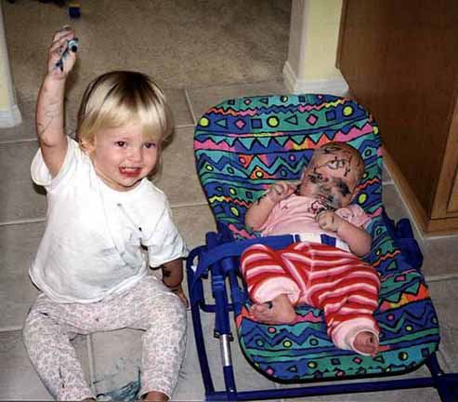
Toddler sitting next to infant in baby seat. Toddler is holding up a felt tip marker and has ink on herself and floor. Infant has drawing all over face and head.
Notes:
A picture’s worth a thousand words

Slide 8
Accessible Literacy Materials and Activities
Adapted for individual visual and auditory challenges
Page turners and page fluffers
Simple text and pictures
Experience books/Remnant books
Tactile books
Object books

Slide 9
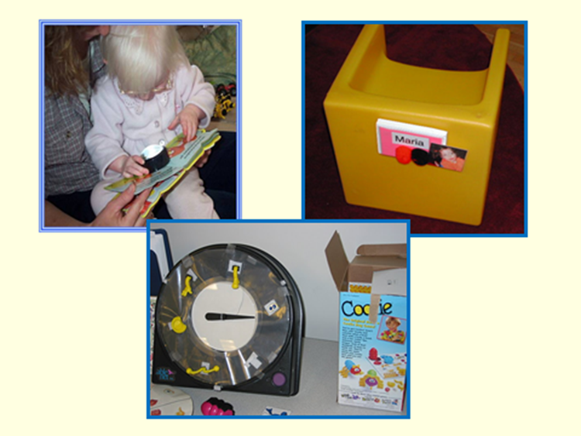
Accessible Literacy Materials and Activities (2 of 2)
Here are some examples:
Opportunities to handle and explore books:
Magnifier for accessibility
Print awareness
Labels, variety of formats
Related skills
Adapted games – builds on turn-taking, matching, following “written” directions
Notes:
Here are some examples:
Opportunities to handle and explore books:
Magnifier for accessibility
Print awareness
Labels, variety of formats
Related skills
Adapted games – builds on turn-taking, matching, following “written” directions

Slide 10
Exposure to Writing Materials: Brailler

Slide 11
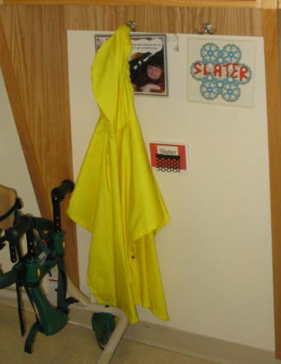
Exposure to Print: Labels (1 of 3)

Slide 12
Exposure to Print: Labels (2 of 3)

Slide 13
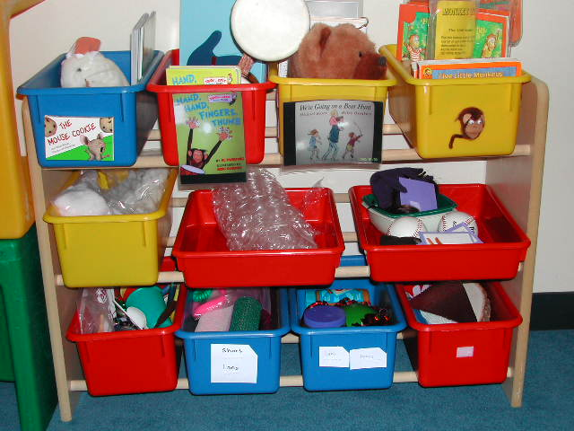
Exposure to Print: Labels (3 of 3)

Slide 14
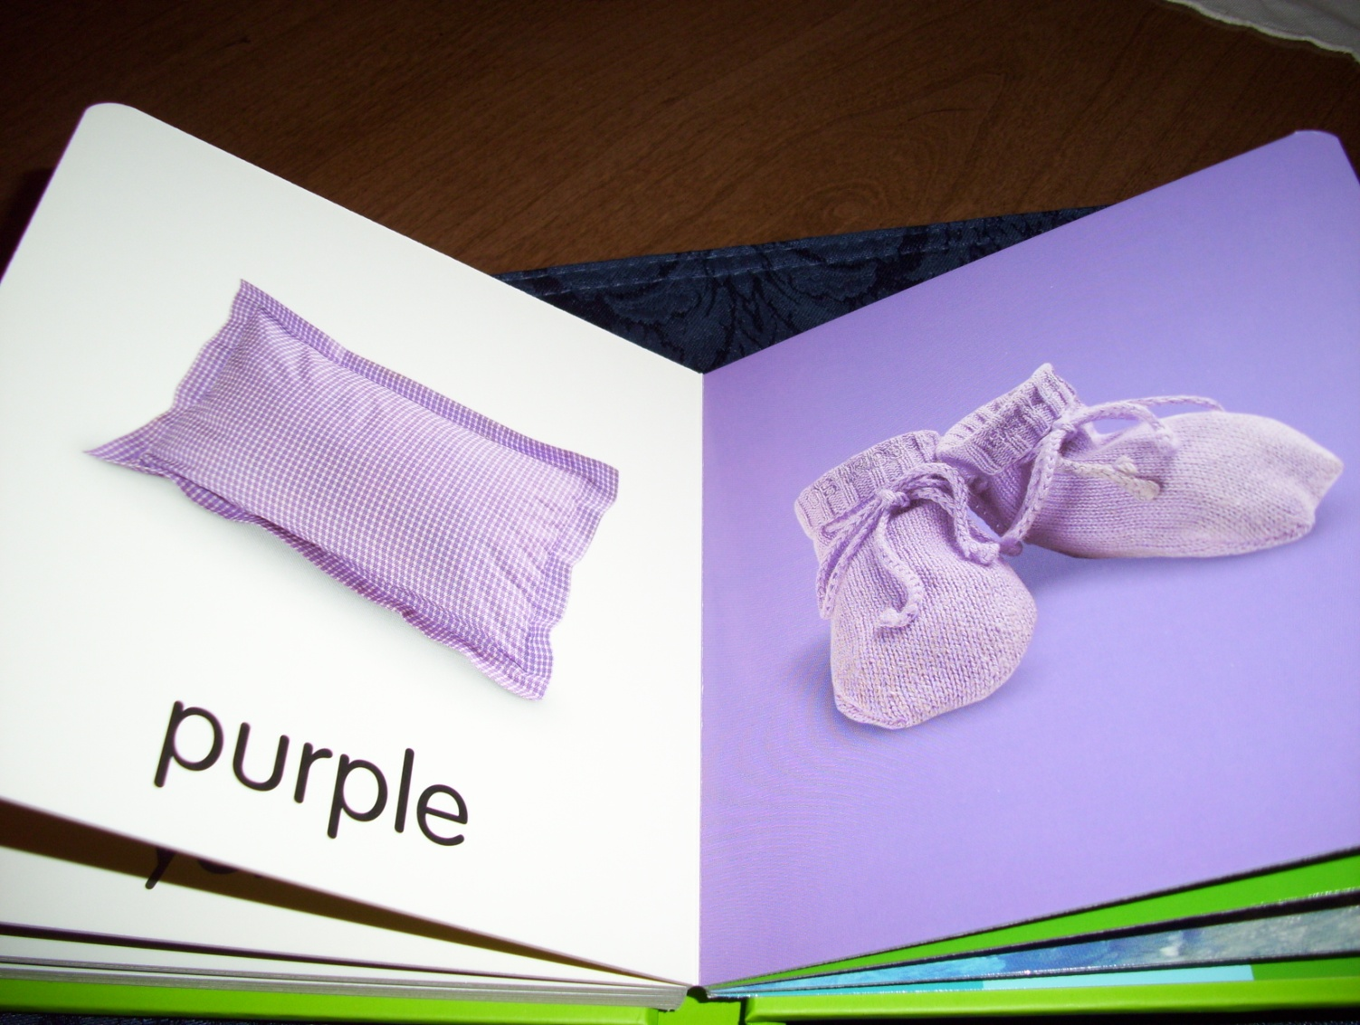
Exposure to Print: Books (1 of 5)
Board book with simple pictures

Slide 15
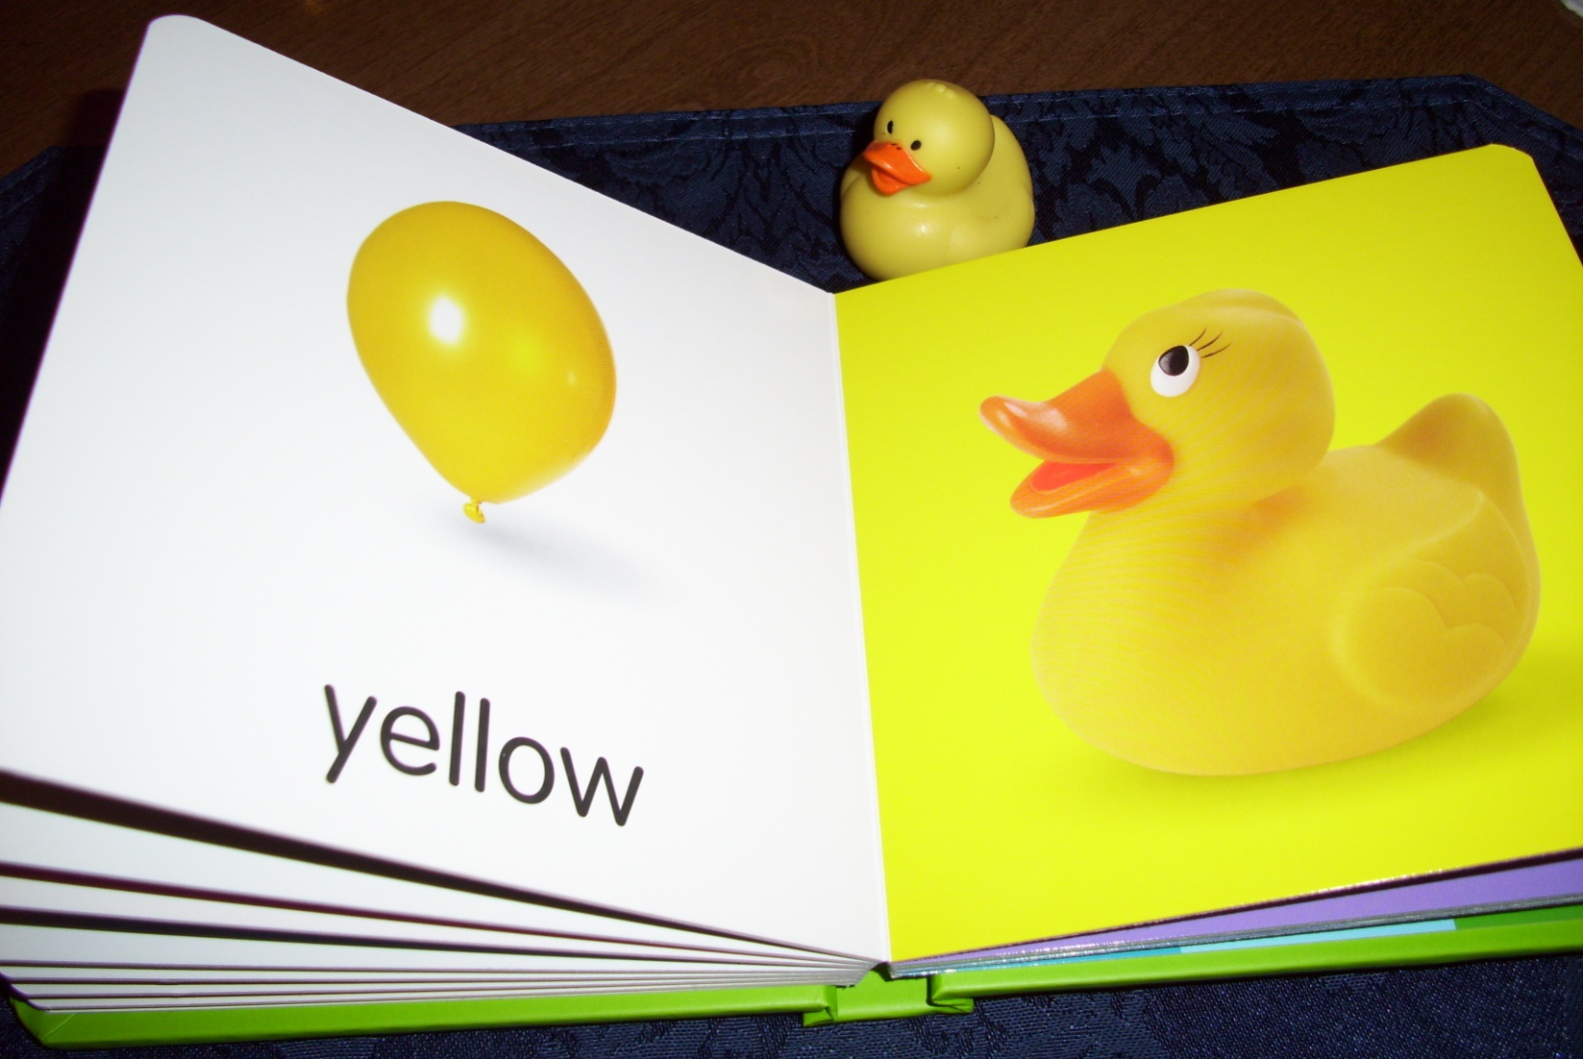
Exposure to Print: Books (2 of 5)
Touch and Feel book with simple pictures

Slide 16
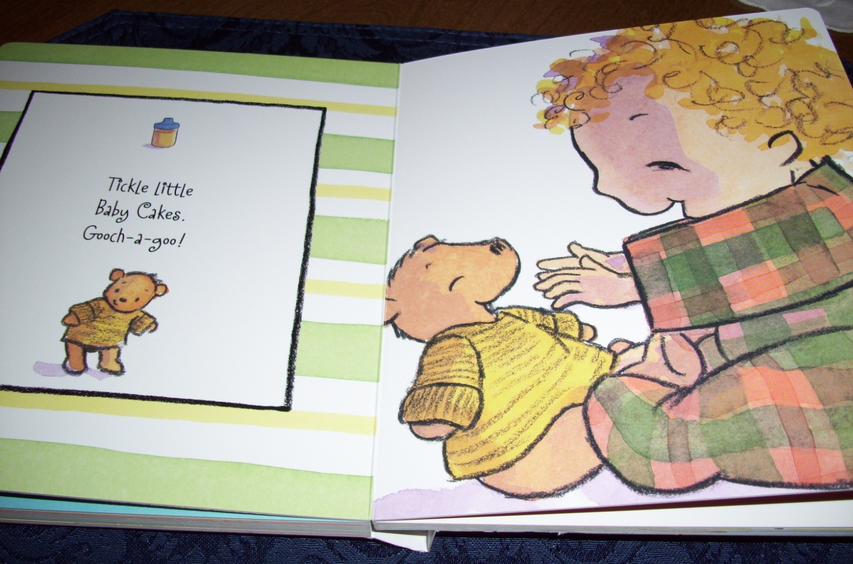
Exposure to Print: Books (3 of 5)
Board book with simple pictures already outlined in black

Slide 17
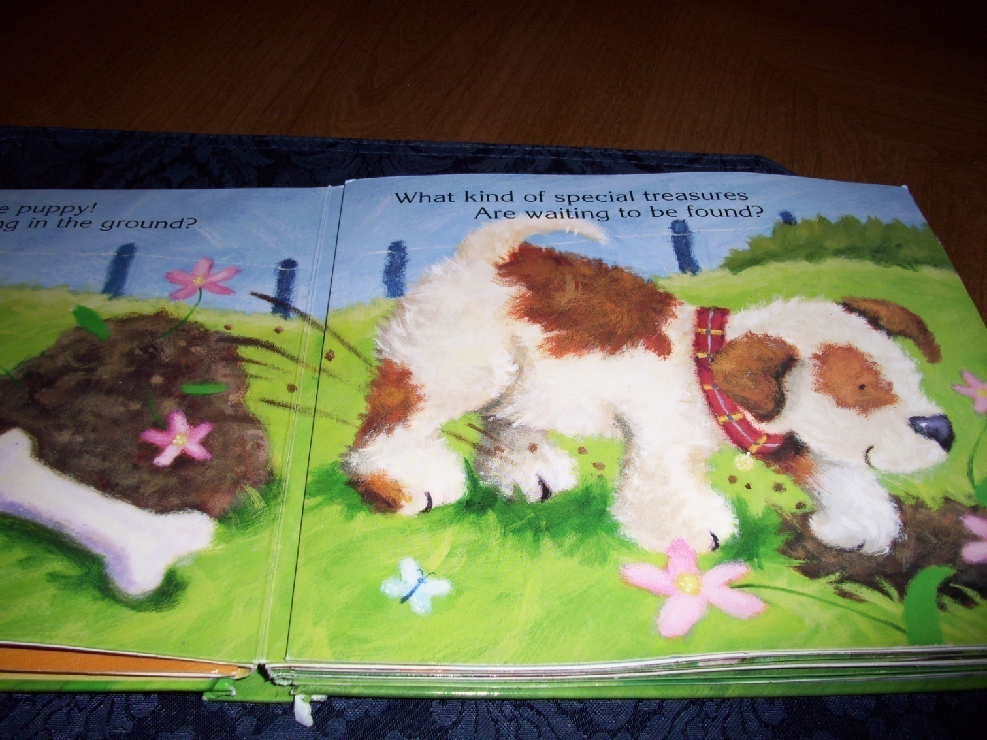
Exposure to Print: Books (4 of 5)
Touch and Feel book with simple pictures

Slide 18
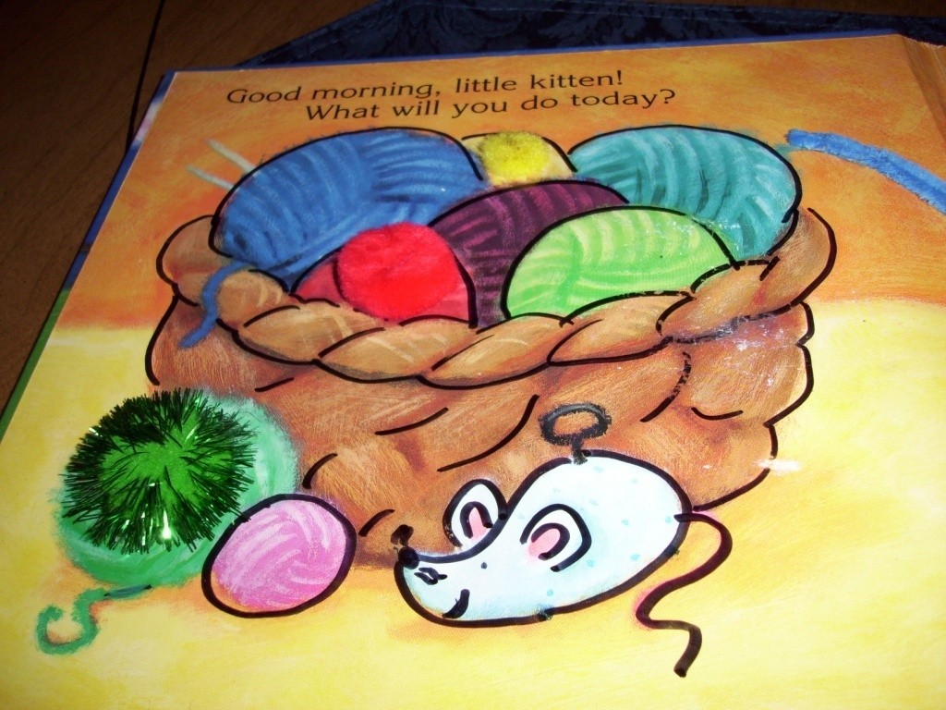
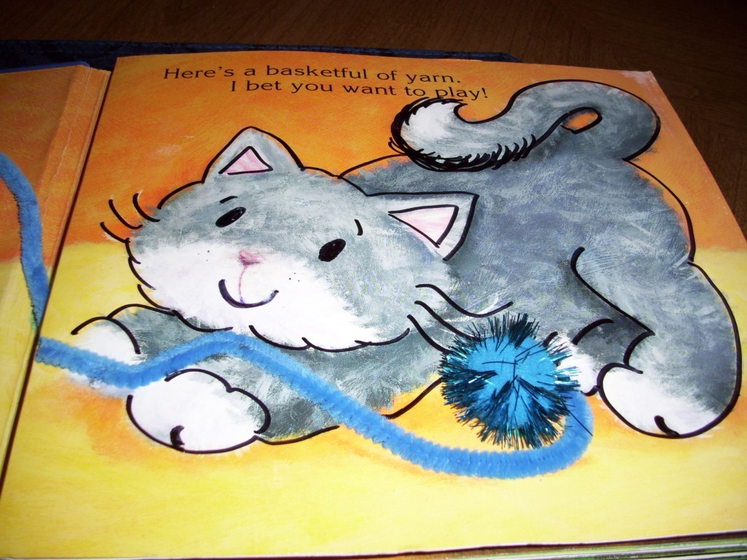
Exposure to Print: Books (5 of 5)
Same book with tactile embellishments

Slide 19
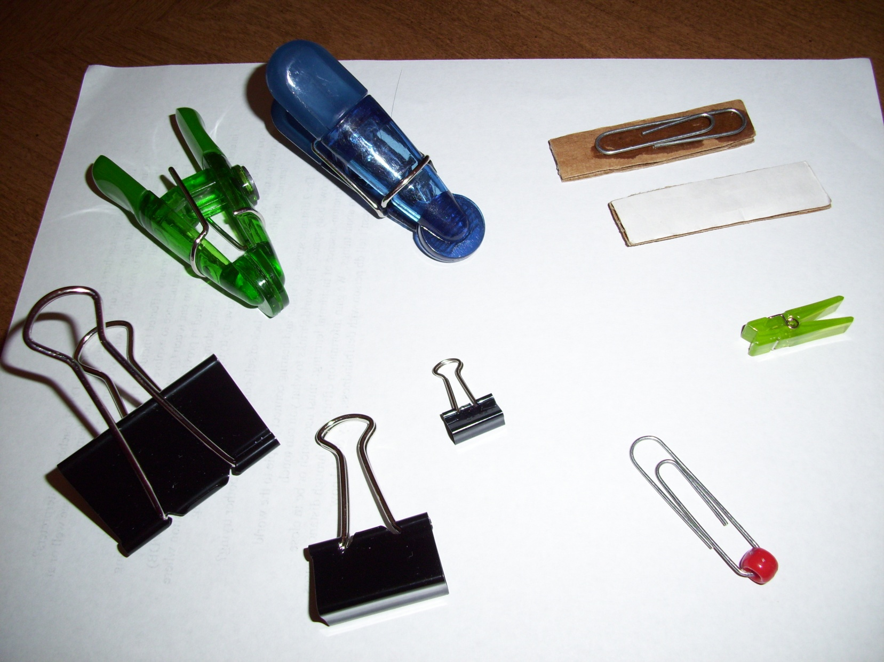
Adapting Books: Page Turners (1 of 2)
Notes:
BOOK
Use cardboard to make pages thicker to make them easier to manipulate and more durable
Add “page fluffers”
Rebind the book so it stays open more easily
Take pages out and put into protective sheets
Laminate pages
Tactile enhancements
Books that are on tape or CD can be adapted with a switch so that a student can continue to read the story by activating the switch
Create an electronic version of the book
Tape, CD, MP3
PPT or other software
Can be made accessible using a switch or touch-screen
PICTURES
Simplify the background
Make accessible for student with CVI
Highlight the main idea of the picture
Provide tactile enhancement to the picture
TEXT
Make text accessible by adding Braille
Make text accessible by replacing smaller print with enlarged print
Provide contrast
Simplify the content
If student is not reading print or Braille at the level of the text in the book
Support print with picture or tactile symbols
! Stop for Show & Tell or add slides with pictures

Slide 20
Adapting Books: Page Turners (2 of 2)
Notes:
BOOK
Use cardboard to make pages thicker to make them easier to manipulate and more durable
Add “page fluffers”
Rebind the book so it stays open more easily
Take pages out and put into protective sheets
Laminate pages
Tactile enhancements
Books that are on tape or CD can be adapted with a switch so that a student can continue to read the story by activating the switch
Create an electronic version of the book
Tape, CD, MP3
PPT or other software
Can be made accessible using a switch or touch-screen
PICTURES
Simplify the background
Make accessible for student with CVI
Highlight the main idea of the picture
Provide tactile enhancement to the picture
TEXT
Make text accessible by adding Braille
Make text accessible by replacing smaller print with enlarged print
Provide contrast
Simplify the content
If student is not reading print or Braille at the level of the text in the book
Support print with picture or tactile symbols
! Stop for Show & Tell or add slides with pictures

Slide 21
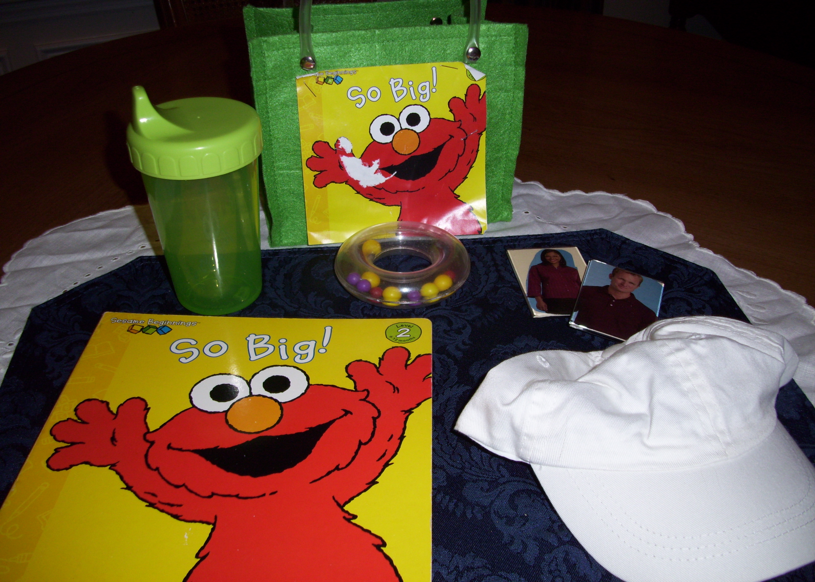
Story Bag: Home or Preschool

