Slide 1
Shifting Your Perspective: Lessons and Insights from Spanish Speaking Families
Alejandro Cuevas
Carlos Martinez
Herlinda Rodriguez
Kenya Sanchez
Mayra Garcia
Sonia Hernandez
Martha de la Torre
Myrna Medina
Notes:
Myrna - on this slide it would be good to mention the Cultural Competency Workgroup - Arkansas, Arizona, California, Florida & USVI, New England Consortium, New York, Texas, and NCDB

Slide 2
Families will share about...
What it was like when their child was initially diagnosed
Their experiences with accessing services
Where they found the most support
Key information that they want other families and providers to know

Slide 3
Desired Outcomes for State Deaf-Blind Projects
review their child count to determine what cultures & languages are represented in their states
examine their internal capacity to serve families from culturally and linguistically diverse backgrounds
seek state level partnerships to support their work in finding, referring, and supporting families from culturally and linguistically diverse backgrounds
have an increased appreciation for a more vulnerable population

Slide 4
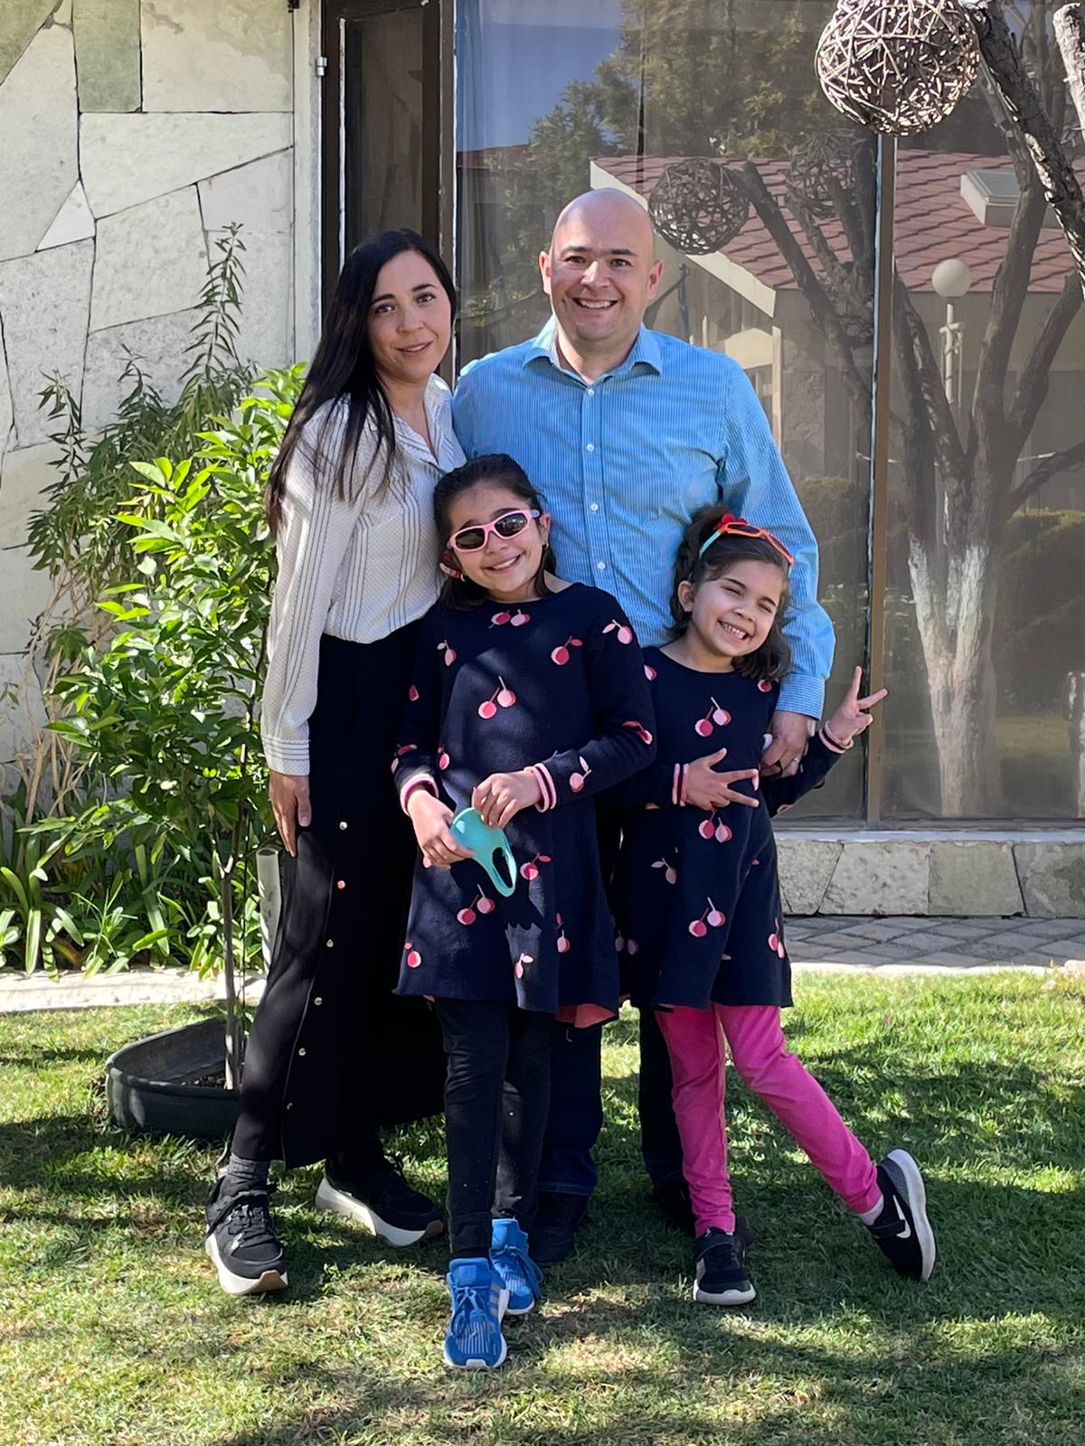
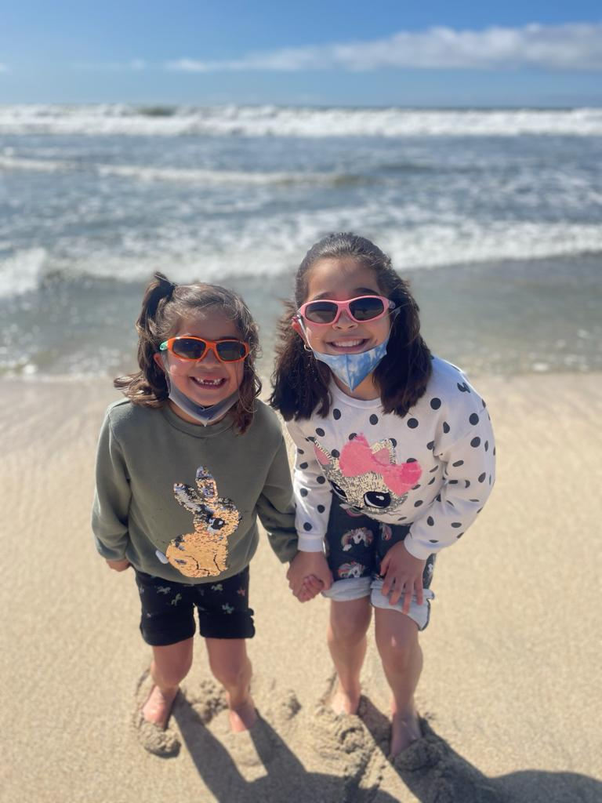
Cuevas Family

Slide 5
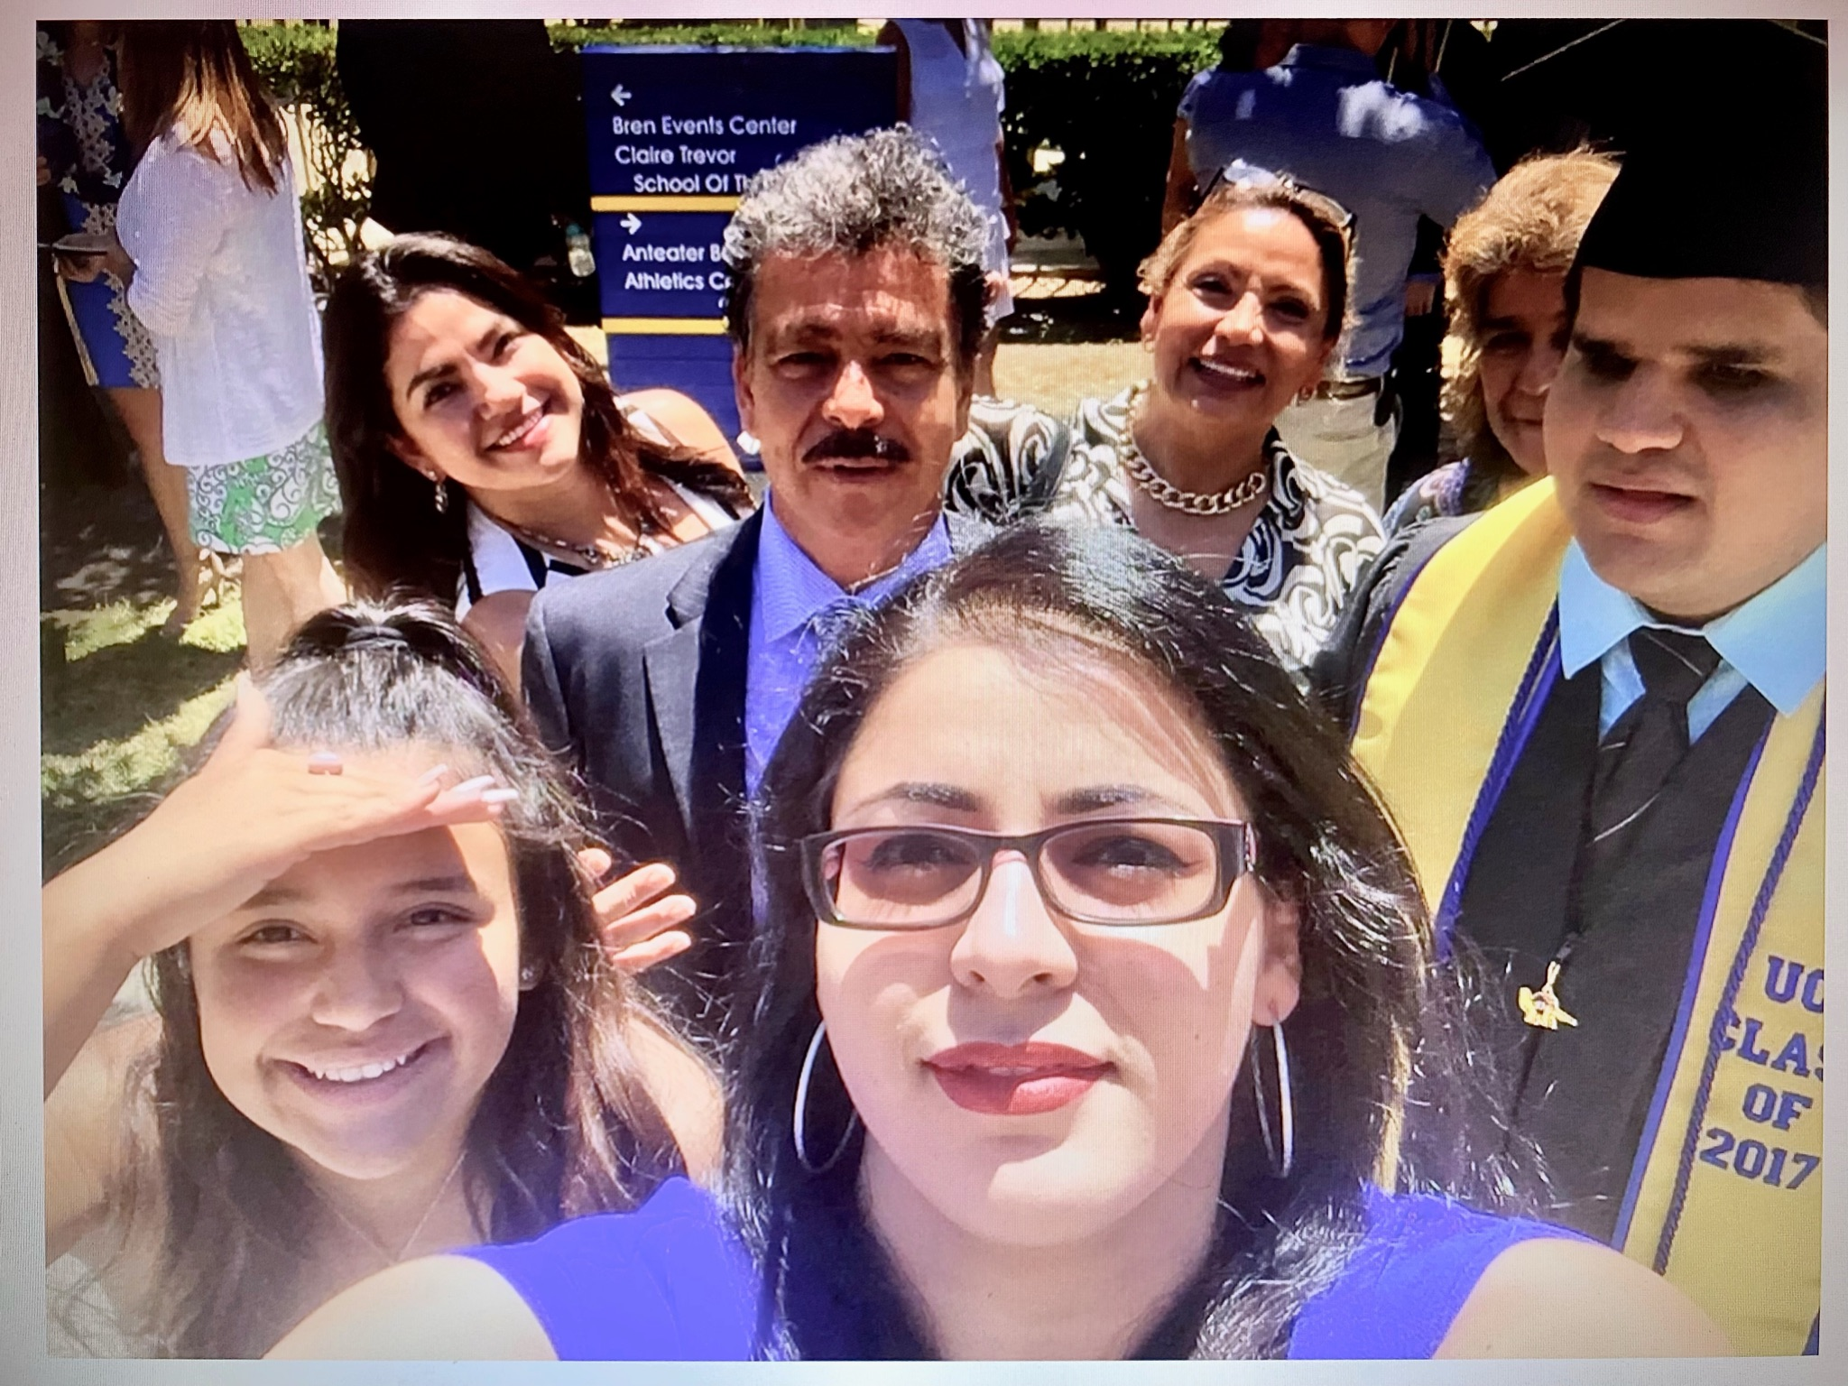
Martinez Family

Slide 6
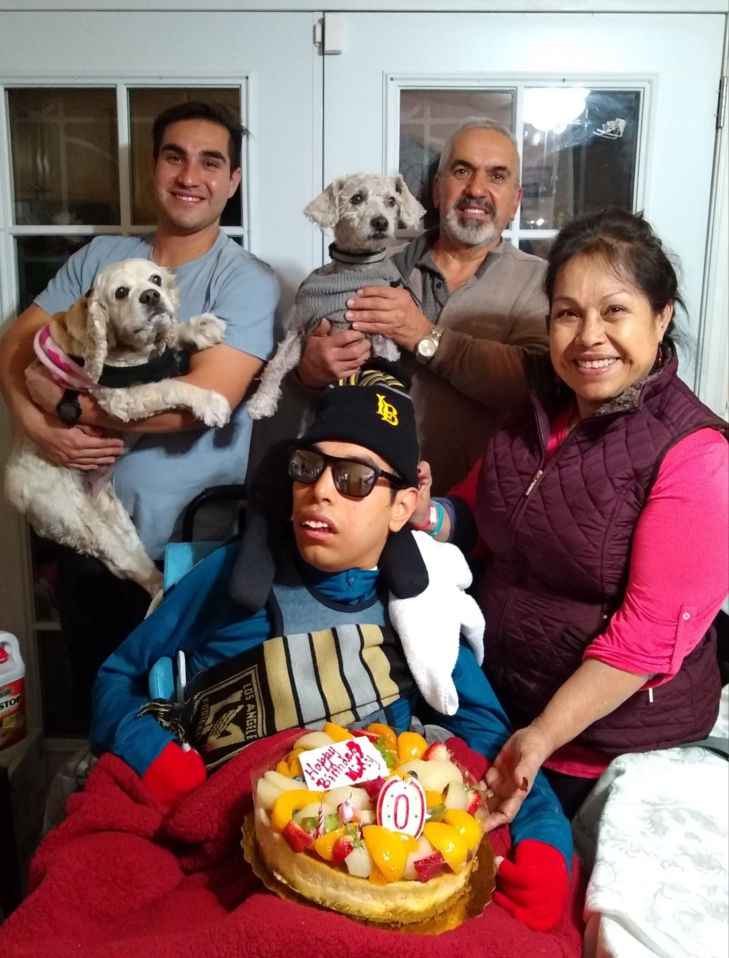
Rodriguez Family

Slide 7
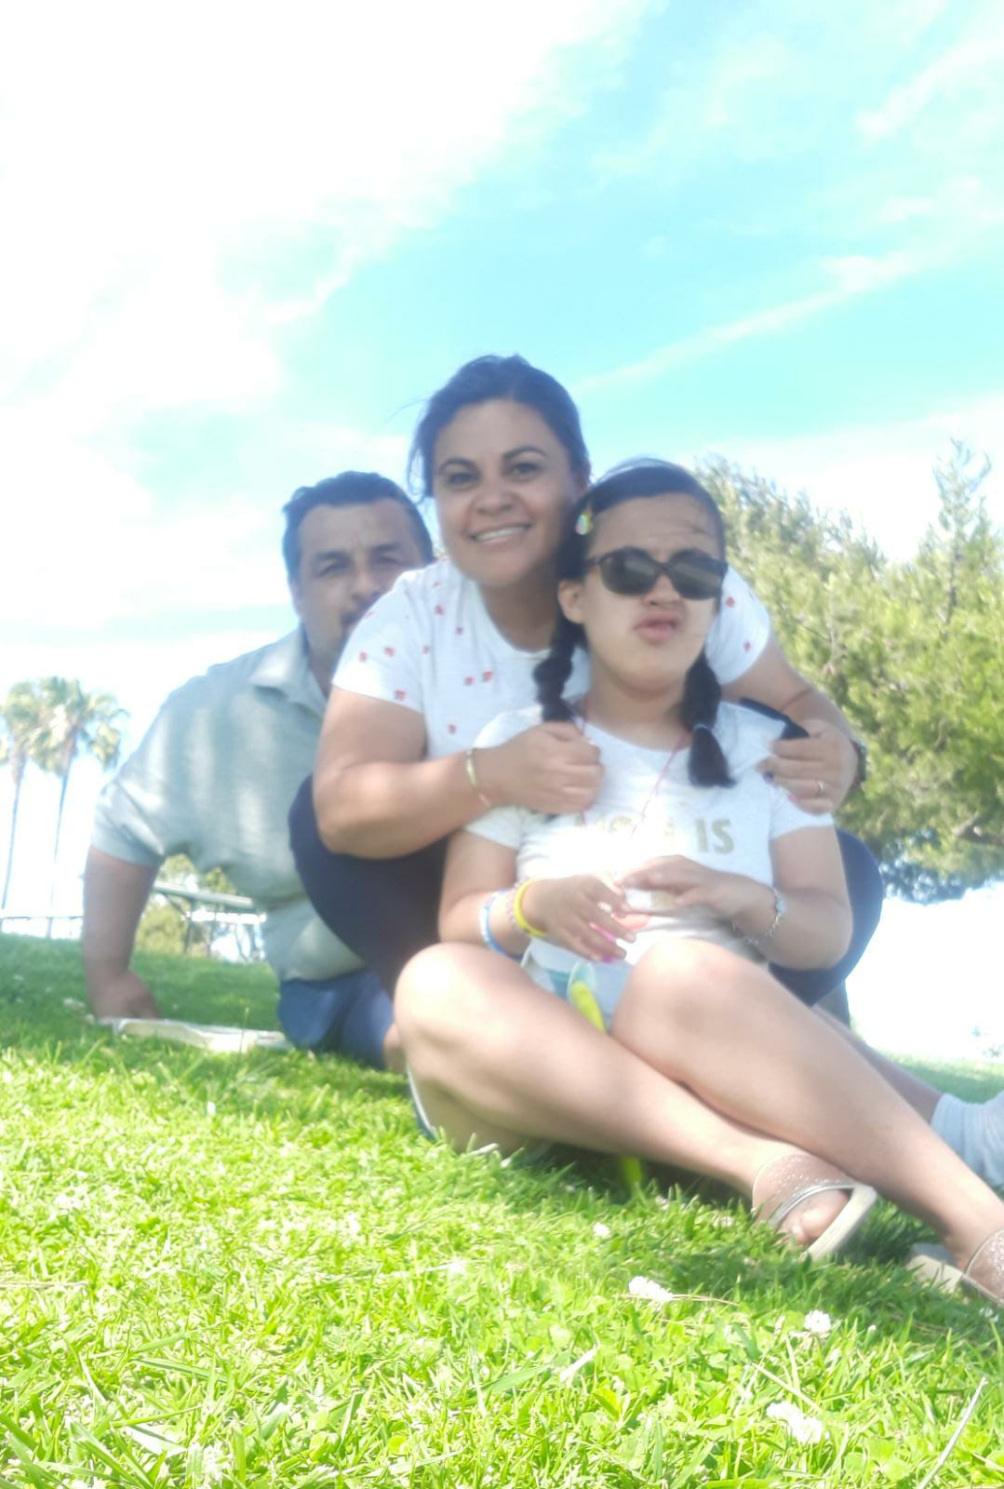
Sanchez Family

Slide 8
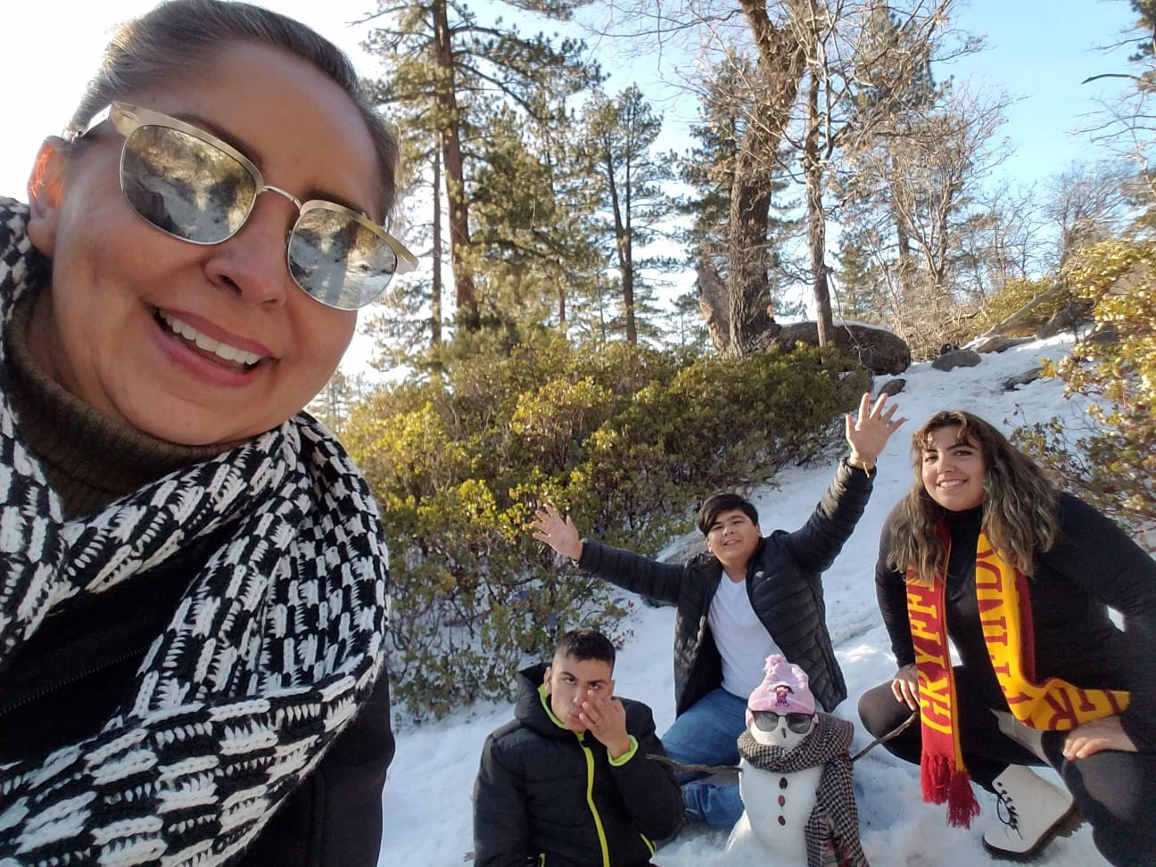
Garcia Family

Slide 9
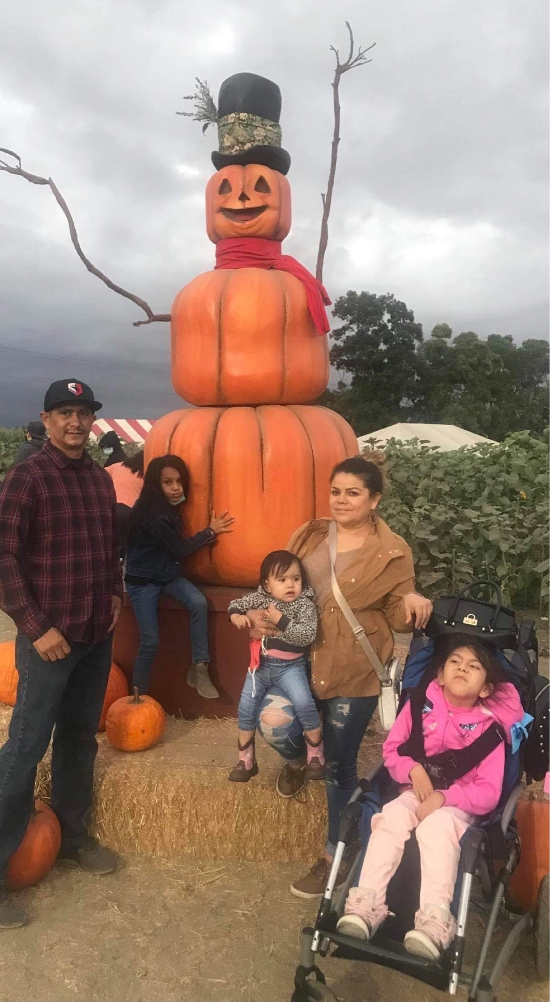
Hernandez Family

Slide 10
Guiding Questions
How was it when your child was first diagnosed?
What was your experience with accessing services?
Where did you find the most support?
Looking back, what do you want to make sure other families know? Providers know?
I Wish I Had…

Slide 11
Next Steps
Examine the Cultural Competency Resource page on the NCDB website.
Create an action plan for your state deaf-blind project
Come prepared to share/learn together @ Deaf-Blind Summit Session One - on July 15th

Slide 12
BIG Thanks
To the family members who shared today
And the following State Deaf-Blind Projects:
Arkansas
Arizona
California
Florida & USVI
New England Consortium
New York
Texas

Slide 13
Final Slide
The contents of this presentation were developed under a grant from the U.S. Department of Education, #H326T180026. However, those contents do not necessarily represent the policy of the U.S. Department of Education, and you should not assume endorsement by the Federal Government. Project Officer, Susan Weigert.

